Slide 1

Benchmarking Assessment Template
A concise layout for comparing the performance and practices of peer organizations as part of a business diagnostic exercise

Slide 2



Benchmarking Assessment – Overview
What is it
The Benchmarking Assessment Template is a clear and simple framework for allowing organizations to be compared across a range of practices, performance measures, metrics or operational attributes in a visually appealing and easy-to-understand format. It can be easily tailored to suit the number of organizations or dimensions being compared, in addition to allowing other qualitative aspects to be highlighted as part of the read-out.
When to use it
The Benchmarking Assessment Template is best utilized as part of an analysis or diagnostics exercise where peer comparisons are being made across multiple organizations with the aim of highlighting areas of significant variation. It is particularly useful when needing to convey comparator variations to a senior executive audience or wide group stakeholders who need to be engaged and involved in action to address apparent performance or practice deficiencies.
Why use it
The Benchmarking Assessment Template is proven to be effective at conveying the critical information emanating from a peer comparison exercise. Its value comes through the ease with which direct comparisons between organizations can be made and, more importantly, communicated to a variety of audiences. Injecting peer comparison insights into a business analysis exercise can be extremely informative at highlighting the need for business transformation.

Slide 3

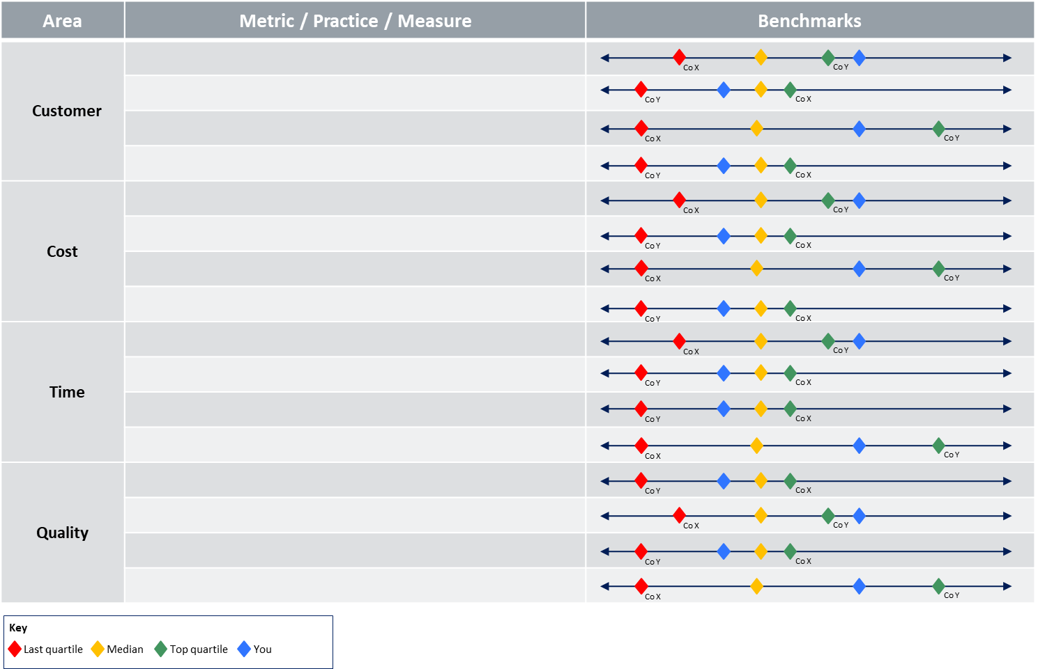
Benchmarking Assessment – Method (Option 1)
How you use it
Step 3. For each metric or practice notate the relative performance and position of your organization compared to peer organizations.
Step 2. Capture the metrics, practices, measures in each area that are being assessed.
Step 1. Capture the key dimensions or drivers that benchmarks, metrics, practices and comparators are being assessed.
Step 4. Use the correct symbols to notate the appropriate quartile positioning.

Slide 4
Benchmarking Assessment – Template (Option 1)
Area | Metric / Practice / Measure | Benchmarks
Customer |  | Co X Co Y
 |  | Co Y Co X
 |  | Co X Co Y
 |  | Co Y Co X
Cost |  | Co X Co Y
 |  | Co Y Co X
 |  | Co X Co Y
 |  | Co Y Co X
Time |  | Co X Co Y
 |  | Co Y Co X
 |  | Co Y Co X
 |  | Co X Co Y
Quality |  | Co Y Co X
 |  | Co X Co Y
 |  | Co Y Co X
 |  | Co X Co Y
Key
Last quartile Median Top quartile You

Slide 5
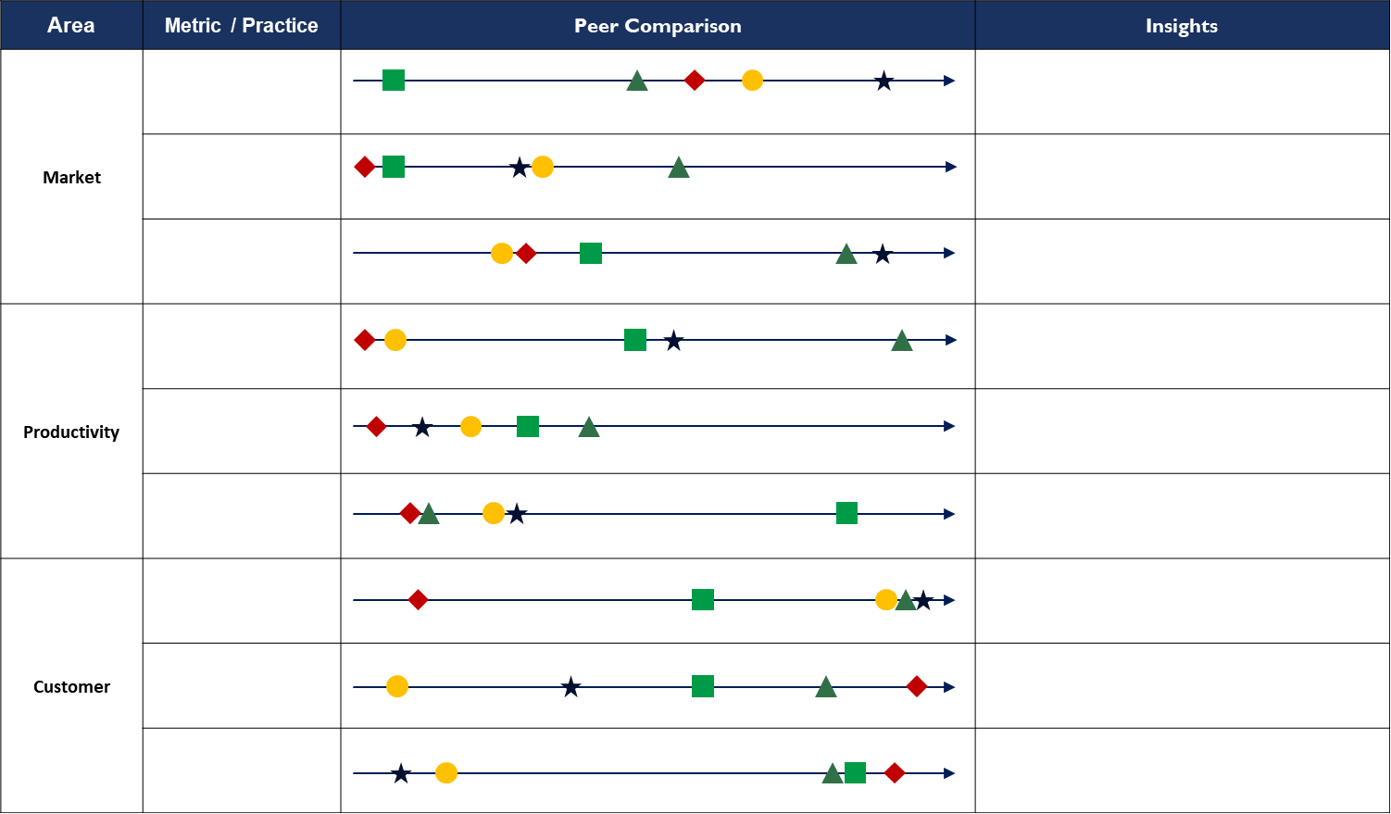
Benchmarking Assessment – Method (Option 2)
How you use it
Step 1. Capture the key dimensions or drivers that benchmarks and comparators are being assessed.
Step 3. For each metric or practice, notate the relative performance and position of your organization compared to peer organizations.
Step 2. Capture the metrics, practices, measures in each area that is being assessed.
Step 4. Capture any insights that emerge from the peer comparison and relative position across metrics and practices

Slide 6
Benchmarking Assessment – Template (Option 2)
Area | Metric / Practice | Peer Comparison | Insights
Market
Productivity
Customer
Comparator A Comparator B
Comparator C Comparator D
Us

