Slide 1

Business Metrics Framework
A proven mechanism for specifying performance metrics to drive and measure transformation progress.

Slide 2



Business Metrics Framework – Overview
What is it
The Business Metrics Framework is a structured approach and template for defining future state business performance metrics in support of a business transformation or improvement program. The framework allows for key requirement and design information to be specified for metrics to then be agreed and progressed into development, deployment, reporting and tracking.
When to use it
The Business Metrics Framework should be used during the design and planning phase of a business transformation or improvement program. The ideal timing for metrics definition is after design of the key future state components is complete (such as operating model, high level processes, vision, objectives) – with the defined metrics providing the means to establish expected and motivational targets for the future state and track progress towards accomplishing these targets.
Why use it
Clear performance metrics are an essential part of any business looking to achieve operational excellence or transform performance and achieve improved results. The first step in establishing effective and aligned metrics is the specification of the requirements, targets and approach. This template is proven in multiple business environments and transformation settings to help organizations outline metrics necessary to motivate and manage transformation progress.

Slide 3

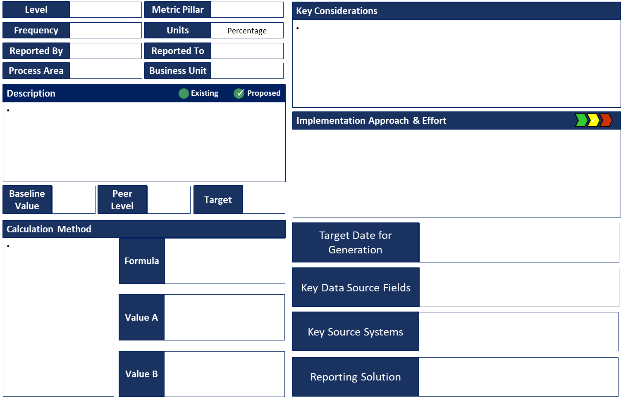
Business Metrics Framework – Method
How you use it
Step 1. Capture the core information on the proposed metrics including level (0, 1, 2…), Pillar (e.g.
Customer, Product, Process, Risk, etc.), Process Area (e.g. Sales, Billing, Care, Design, etc.).
Step 4. Capture the key considerations, risks, unknowns in relation to using this metric.
Step 6. Describe the implementation approach and associated effort and risks.
Step 7.
Capture key dates, data sources and reporting system approach.
Step 2. Describe the metric including its purpose, business need and value.
Step 3. Capture the current level (if known), peer levels and the target.
Step 5. Describe the method for calculating the metric, including key input variables and the exact calculation formula.

Slide 4

Business Metrics Framework – Template
Level |  |  | Metric Pillar
Key Considerations
Frequency |  |  | Units | Percentage
•
Reported By |  |  | Reported To
Process Area |  | Business Unit
Description
Existing 🗸 Proposed
•
Implementation Approach & Effort
🗸 🗸
Baseline Value |  | Peer Level
Target
Calculation Method
Target Date for
Generation
•
Formula
Key Data Source Fields
Value A
Key Source Systems
Value B
Reporting Solution

