Slide 1

Business Stakeholder Map
Understand, engage, influence and manage your business stakeholders with this proven mapping approach

Slide 2



Business Stakeholder Map – Overview
What is it
The Business Stakeholder Map is a method and framework for evaluating the disposition of business stakeholders (individuals and groups) in relation to a transformation program. The map allows stakeholders to be plotted to assess their relative degree of influence and support over a transformation program. Using this assessment, stakeholder engagement and communication activities can be initiated to help “move” stakeholders to the desired level of support relative to their influence.
When to use it
A Stakeholder Disposition Map should be developed at the commence of a transformation program – during the planning cycle and it should be continually refined and updated to include new stakeholders and adjust the changing disposition of existing stakeholders. As the stakeholder map is developed, stakeholder actions and disposition should be tracked using the Stakeholder Tracking Sheet.
Why use it
Business Transformation Program’s succeed on the back of well managed and engaged stakeholders.
Moreover, a critical and common root cause of transformation program failure is the failure to adequately understand and engage with key stakeholders across the spectrum. While simple in form, this template will help to keep awareness and focus around stakeholder engagement. This template should be used in conjunction with the other stakeholder mapping and management tools found on experttoolkit.com.

Slide 3

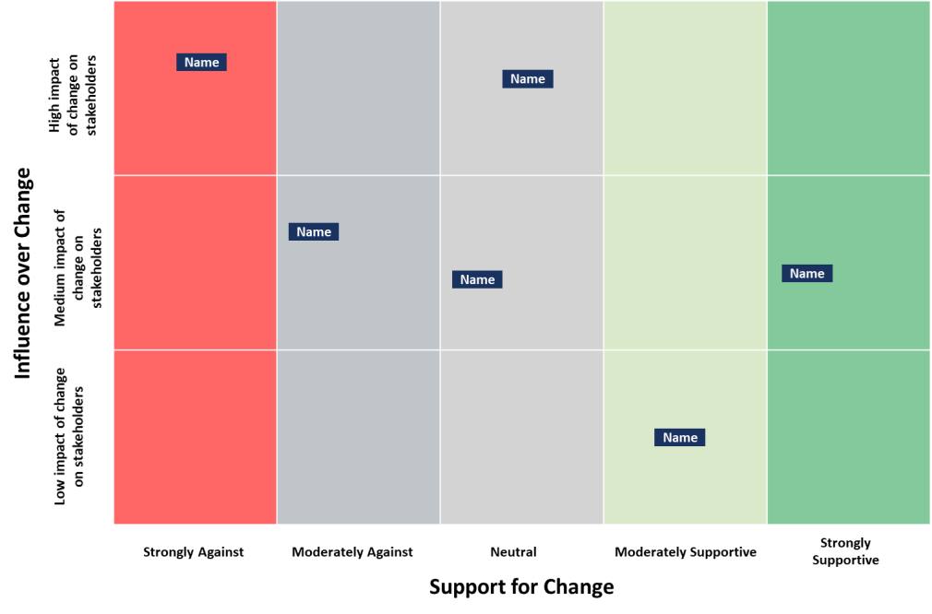
Business Stakeholder Map – Method (Option 1)
How you use it
Plot. Plot stakeholders (individuals or groups) on the map according to their disposition towards to the program.
Optional: Plot the desired disposition for each stakeholder (individuals or groups). Where do we want them to be?
Track: Track stakeholder disposition, engagement and actions on the Stakeholder Tracking Sheet.
Y-Axis. How much can the stakeholder influence the success of the program?
X Axis. How much does the stakeholder support the transformation program?
A more comprehensive “How to” guide for Stakeholder Mapping can be found on experttoolkit.com

Slide 4
Business Stakeholder Map – Template (Option 1)
Name |  | Name
 | Name | Name |  | Name
 |  |  | Name
High impact
of change on stakeholders
Influence over Change
Medium impact of
change on stakeholders
Low impact of change
on stakeholders
Strongly Against
Moderately Against
Neutral
Moderately Supportive
Strongly Supportive
Support for Change

Slide 5
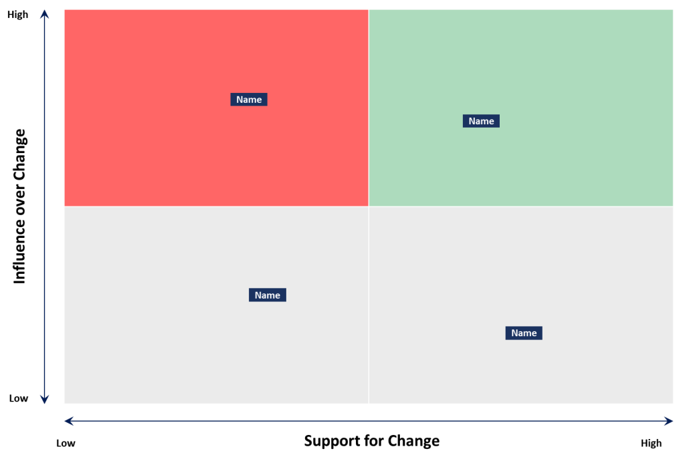
Business Stakeholder Map – Method (Option 2)
How you use it
Plot. Plot stakeholders (individuals or groups) on the map according to their disposition towards to the program.
Optional: Plot the desired disposition for each stakeholder (individuals or groups). Where do we want them to be?
Track: Track stakeholder disposition, engagement and actions on the Stakeholder Tracking Sheet.
Y-Axis. How much can the stakeholder influence the success of the program?
X Axis. How much does the stakeholder support the transformation
program?
A more comprehensive “How to” guide for Stakeholder Mapping can be found on experttoolkit.com

Slide 6
Business Stakeholder Map – Template (Option 2)
High
Name | Name
Name | Name
Influence over Change
Low
Low
Support for Change
High

