Slide 1
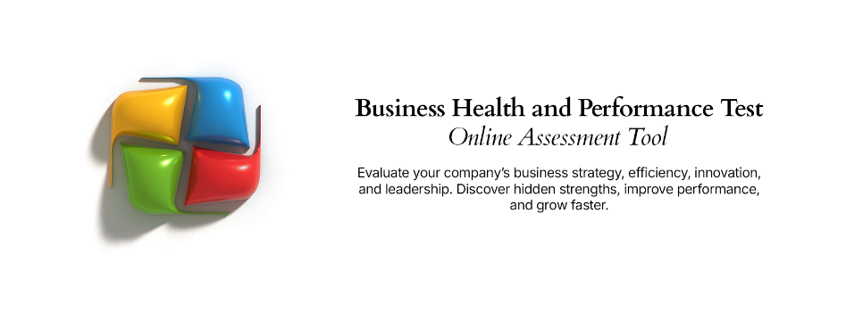
Cost Benefit Assessment Framework
A proven, simple and flexible model for evaluating the costs and benefits of business improvement initiatives

Slide 2



Cost Benefit Assessment Framework –
Overview
What is it
The Cost-Benefit Assessment Framework is a proven and easily customizable model for evaluating the costs and benefits of business improvement initiatives. It allows a business analyst or project owner to summarize the key dimensions that need to be considered when evaluating the worthiness of potential business improvement initiatives. The structure can be tailored to suit the specific requirements of the business, however the layout presented here is considered best practice.
When to use it
The Cost-Benefit Assessment Framework should be used to objectively evaluate business improvement initiatives and socialize them with executive stakeholders for selection and endorsement. The framework is designed to be used at the conclusion of an “analysis and design” exercise where issues are known in- depth and potential improvement projects have been identified, assessed and scoped. It is typical that additional financial worksheets will be created to support the information presented in this framework.
Why use it
The Cost-Benefit Framework is flexible and proven to work across a range of industries, environments and business improvement portfolio types. It provides a concise and structured mechanism for outlining potential improvement initiatives and prioritizing them based on pre-defined objective criteria – such as cost, financial return, strategic alignment, customer advocacy impact and benefit accomplishment risk.

Slide 3

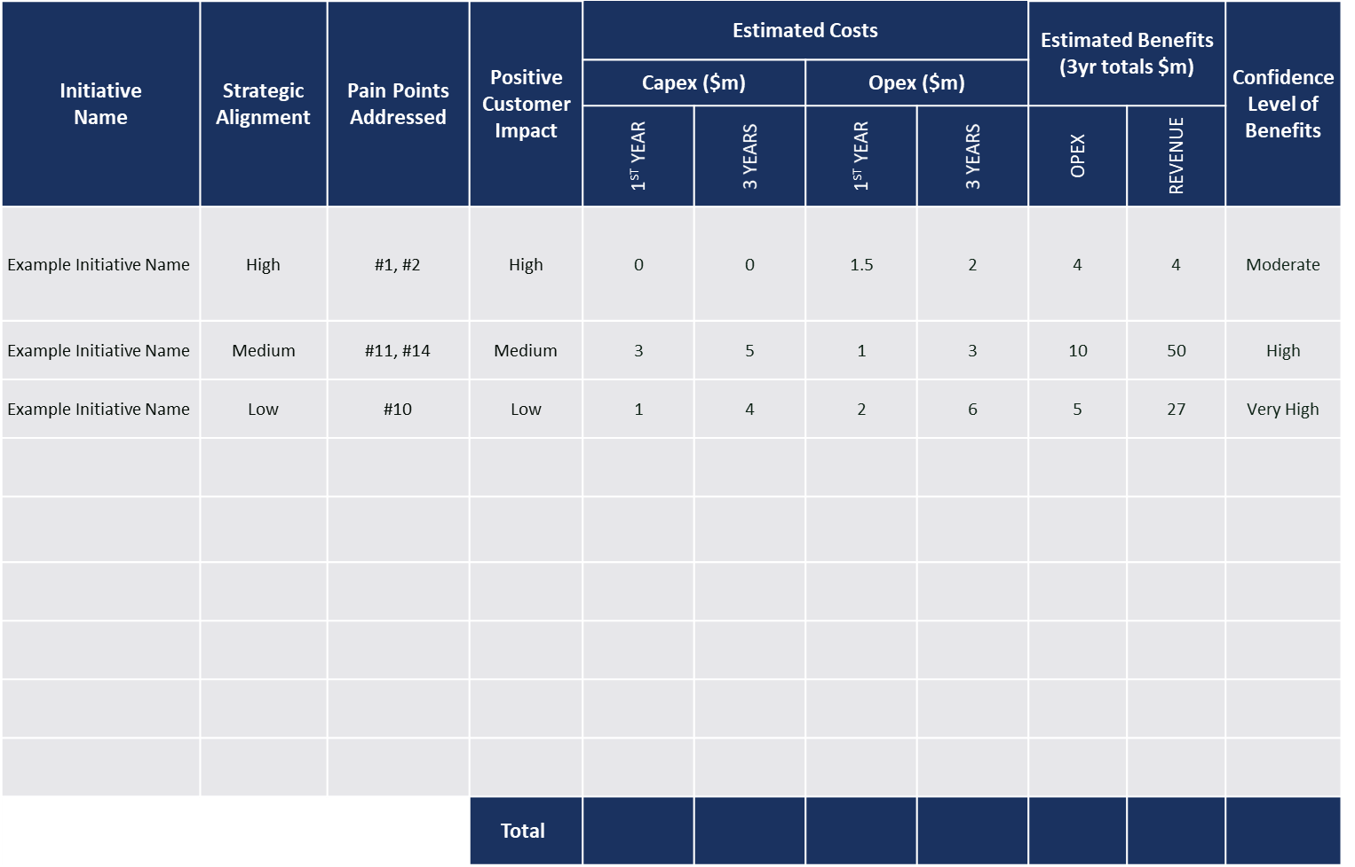
Cost Benefit Assessment Framework –
Method
How you use it
Step 2: For each | Step 3: For each | Step 4: For each initiative, | Step 5: For each initiative, | Step 6: For each
initiative, provide a | initiative, identify | provide a qualitative rating | provide details of Cost | initiative, indicate the
qualitative rating of | the pain points | for the extent the initiative | (OpEx, CapEx) and | confidence level in the
alignment to strategic | that will be | will have a positive impact | benefits (OpEx, Revenue) | benefits being
objectives. | remediated. | on customers. | over 1 and 3 years. | achieved.
Step 1: List the
business improvement
initiatives being
evaluated.
 |  |  |  | Step 7: Total the
 |  |  |  | results in order to
 |  |  |  | assess the overall
 |  |  |  | improvement portfolio.

Slide 4
Cost Benefit Assessment Framework –
Template
Initiative Name | Strategic Alignment | Pain Points Addressed | Positive Customer Impact | Estimated Costs |  |  |  | Estimated Benefits (3yr totals $m) |  | Confidence Level of Benefits
 |  |  |  | Capex ($m) |  | Opex ($m)
 |  |  |  | 1ST YEAR | 3 YEARS | 1ST YEAR | 3 YEARS | OPEX | REVENUE
Example Initiative Name | High | #1, #2 | High | 0 | 0 | 1.5 | 2 | 4 | 4 | Moderate
Example Initiative Name | Medium | #11, #14 | Medium | 3 | 5 | 1 | 3 | 10 | 50 | High
Example Initiative Name | Low | #10 | Low | 1 | 4 | 2 | 6 | 5 | 27 | Very High
 |  |  | Total

