Slide 1
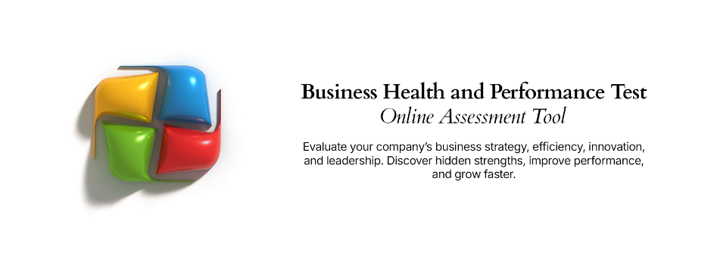
Customer Experience Design Framework
A proven, simple approach for outlining a customer experience vision and design for an organization

Slide 2



Customer Experience Design – Overview
What is it
The Customer Experience Design Framework is simple-to-use, but very effective framework at structuring analysis and design of customer experience improvement. It uses three components to drive analysis,
“visioning” and discussion: 1. The aspirational customer experience; 2. The current customer experience; and 3. The experience delivered by competitors. Using this simple model, aligned to the core steps taken by a customer along their experience journey allows improvement to be targeted for greatest return.
When to use it
The Customer Experience Framework is best suited to a future-state design exercise that is concentrating on the customer experience vision and design of an organization. To be most effective, some level of analysis and insight on the current state and competitor experiences will be available. Using this information, a business analyst can then facilitate a group of stakeholders to design an aspirational customer experience and from there agree on where the maximum improvement effort is required.
Why use it
The power of this Customer Experience Design Framework comes through its simplicity and adaptability. It can be tailored to any customer experience journey, any level of detail and any number of customer journey steps. It is also very effective when used to engage stakeholders during a future state customer
experience design or “visioning” exercise in addition to executive socialization discussions aimed at
soliciting buy-in and endorsement for process improvement or transformation.

Slide 3

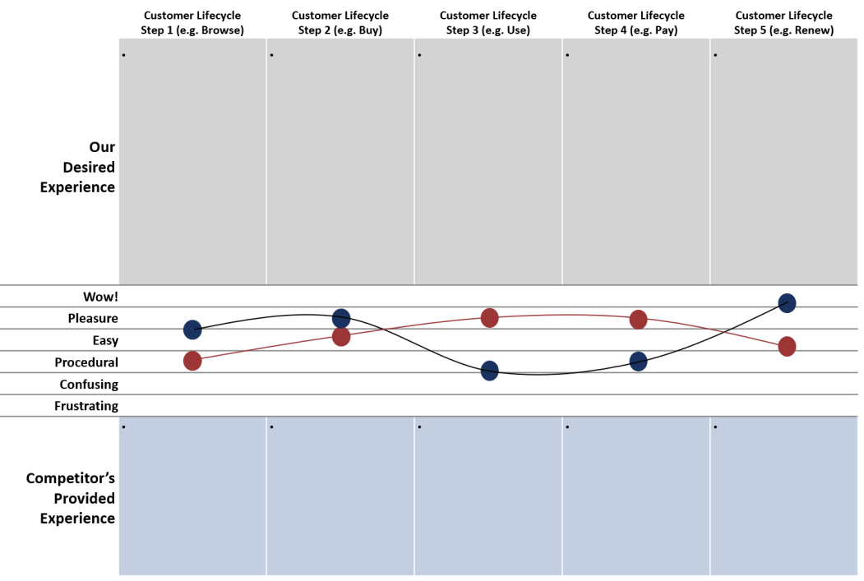
Customer Experience Design – Method
How you use it
Step 1: Identify the process steps that customers move through. The framework can be used at the highest process level or used at lower level process steps (for example the steps to purchase). Add steps along the horizontal as required.
Step 2: For each process step, summarize the experience that is being targeted for delivery to the customer.
Step 4: Draw experience curves
that represent your organization’s delivered experience and the experienced delivered by your primary competitor.
Step 3: Summarize the key points that represent the experience provided to customers by your primary competitor.
Step 5: Use the identified gaps in the experience curves and commentary (Steps 2 and 3) to identify process areas requiring the greatest improvement based on the difference between the current experience, competitor’s experience and the aspirational experience.

Slide 4








Customer Experience Design – Template
Step 1 (e.g. Browse)
Step 2 (e.g. Buy)
Step 3 (e.g. Use)
Step 4 (e.g. Pay)
Step 5 (e.g. Renew)
Desired Experience | • | • | • | • | •
Wow! Pleasure
Easy Procedural Confusing Frustrating
Competitor’s Current Experience | • | • | • | • | •

