Slide 1

Failure Mode Effects Analysis
A proven analysis method for identifying and preventing business process failures and errors

Slide 2



Failure Mode Effects Analysis – Overview
What is it
Failure Mode Effects Analysis (FMEA) is a method for analyzing potential ways in which a process could fail impacting process performance, output quality, customer satisfaction. FMEA works by using a consistent classification approach in which failures are prioritized based on severity, detectability and likelihood.
Failure modes are errors or defects in a process, design, or item, especially those that affect the customer, and can be potential or actual. Effects analysis refers to the evaluation of the consequences of failures.
When to use it
FMEA is a useful method for identifying and analyzing the potential “break points” of a process. It helps ask the questions – “where could this process go wrong, how bad will it be when it goes wrong, how likely will we see it has gone wrong and be able to correct it”. Using the objective assessment and scoring approach, FMEA can be used to focus improvement efforts in areas likely to cause greatest impact. FMEA is a valuable technique to utilize in any process analysis exercise where control and output quality is critical.
Why use it
A successful FMEA activity helps a business analysis team identify potential failure scenarios based on past experience, similar products or processes. This then enables improvements to be crafted that design those failures out of the process or system with the minimum of effort and resource expenditure, thereby reducing development time and costs. FMEA is widely used in a variety of industries and is applicable to product and service oriented processes.

Slide 3

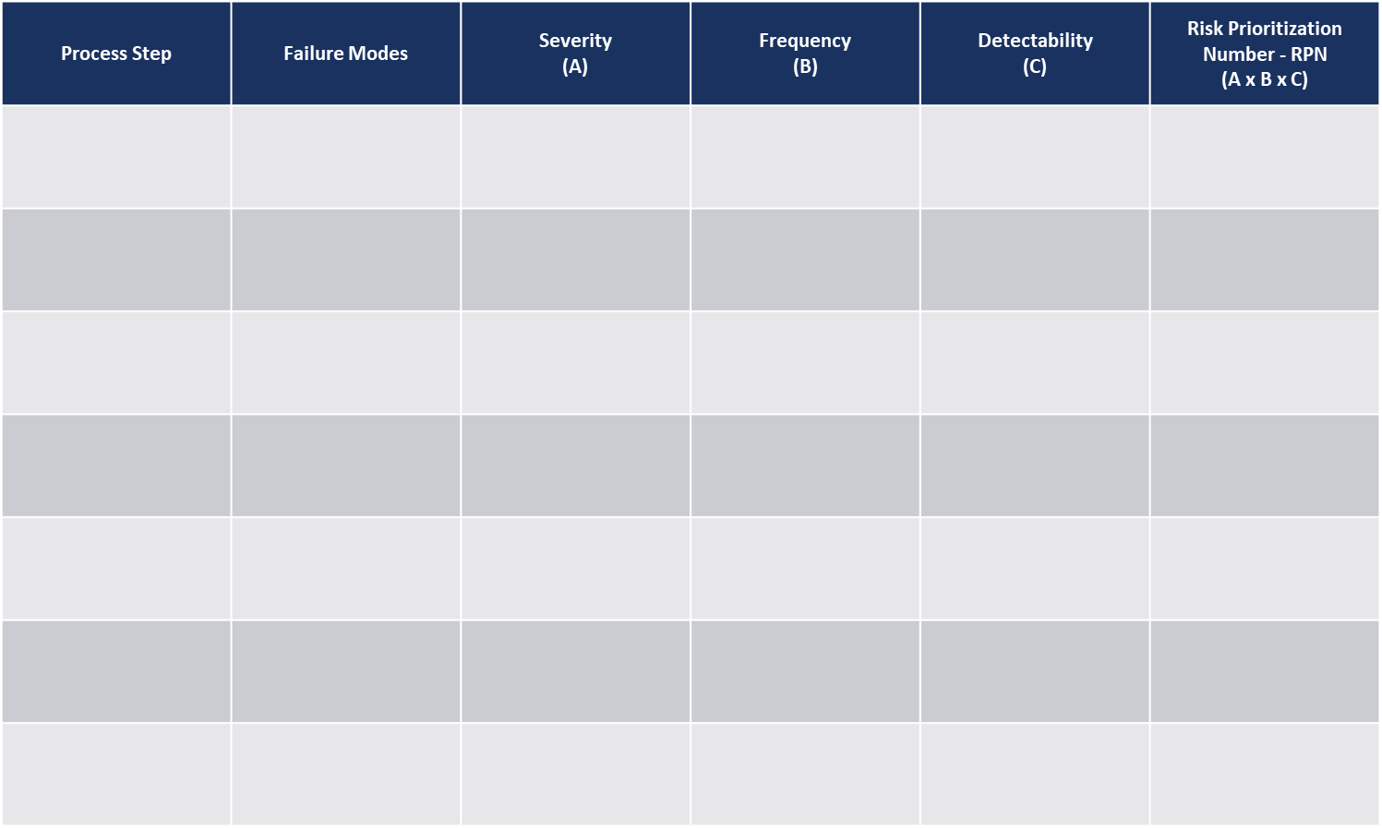
Failure Mode Effects Analysis – Method
How you use it
Step 2.
Identify and capture the potential modes (methods) in which the process can fail.
Step 3.
Rank the severity or impact of a process failure (A)
Step 4.
Rank the likelihood or frequency of a process failure (B).
Step 5.
Rank the likelihood the failure won’t be detected, controlled or prevented (C).
Step 1.
Capture the process
steps or tasks.
Step 6.
Calculate the Risk Prioritization Number (RPN) by multiplying A x B x C.
Step 7.
Rank the process failures by RPN and direct process improvement / remediation activity at those areas with the highest RPN.
Tables for A, B and C are shown on the next page

Slide 4
Failure Mode Effects Analysis – Method
How you use it
Rating | Meaning
1 | No effect
2 | Very minor – only noticed by highly discriminating customers
3 | Minor – noticed by the average customer but functionality not affected
4-6 | Moderate – most customers are frustrated by the error and will complain
7-8 | High – loss of primary function and customers likely to defect, cancel
9-10 | Very High and Hazardous – inoperative, could result in critical error, injury or death
Step 3.
Severity (A)
Rating | Meaning
1 | No known occurrences on similar processes
2-3 | Low – relatively few failures
4-6 | Moderate – occasional process failures
7-8 | High – repeated failures occur
9-10 | Very-High – almost inevitable that failures will occur
Rating | Meaning
1 | Certain – tests will detect fault
2 | Almost certain fault will be detected
3 | High likelihood fault will be detected and prevented
4-6 | Moderate likelihood fault will be detected and prevented
7-8 | Low – manual inspection required and high likelihood faults will be missed
9-10 | Fault very likely to be passed on to customer
Step 4.
Frequency (B)
Step 5.
Detectability (C)

Slide 5
Failure Mode Effects Analysis – Template
Process Step | Failure Modes | Severity (A) | Frequency (B) | Detectability (C) | Risk Prioritization Number - RPN (A x B x C)

