Slide 1

Future State Process Change Summary Template
A concise format for outlining the key changes and improvements required to optimize a business process

Slide 2



Future State Process Change Summary –
Overview
What is it
The Future State Process Change Summary Template is complementary to the Process Issues Summary Template. It is a clean and structured method for highlighting proposed improvements to a process in addition to the corresponding initiatives that need to be initiated in order to implement the improvements.
When to use it
The Future State Process Change Summary should be used at the conclusion of a process analysis exercise to convey in a summary form the information necessary for stakeholders to understand the recommended improvements. The change summary should be supplemented by more detailed process analysis conducted by the business analysis, which should support the findings and recommendations.
Why use it
The Future State Process Change Summary is a proven, clear and logical format for conveying the changes and initiatives necessary for driving business process improvement. It works very well with a variety of stakeholders and is particularly useful with executive audiences who primarily need to know the summary of the recommendations requiring endorsement.

Slide 3

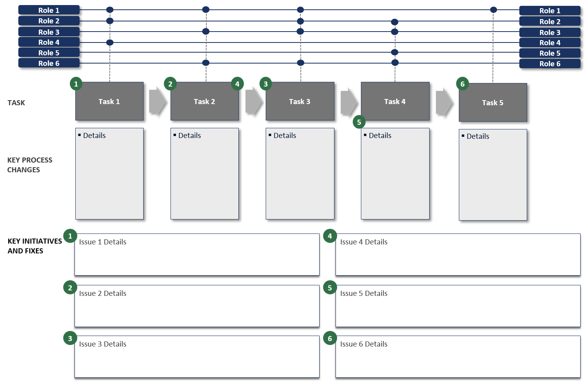
Future State Process Change Summary –
Method
How you use it
Step 1. List the roles that are involved in supporting the future-state process.
Step 2. List the key tasks or process steps that are involved in delivering the future-state process.
Step 3. Describe in detail the changes that are proposed in the current process to implement the future process.
Step 4. Document the initiatives and fixes that need to be implemented in order to deliver the changes required of the future-state process..
Step 5. Notate the fixes against the process steps that will be impacted by the fixes or improvement initiatives.

Slide 4










































Future State Process Change Summary –
Template
Role 1
Role 1
Role 2
Role 2
Role 3
Role 3
Role 4
Role 4
Role 5
Role 5
Role 6
Role 6
1
2
4
3
6
TASK
Task 1
Task 2
Task 3
Task 4
Task 5
5
Details
Details
Details
Details
Details
KEY PROCESS CHANGES
KEY INITIATIVES AND FIXES
1
Issue 1 Details
4
Issue 4 Details
2
Issue 2 Details
5
Issue 5 Details
3
Issue 3 Details
6
Issue 6 Details

