Slide 1

Operating Model Template
A user-friendly, proven and configurable template for capturing and representing a business operating model

Slide 2



Operating Model Template – Overview
What is it
The Operating Model Template is framework for taking some of the mystery and struggle out of putting an operating model down on paper. People often find it difficult to draw a single-page operating model to suitably represent the current or future state of a business, organization or function. The Operating Model Template is aimed at making this easier by including the typical, core components of a good operating model and allowing the effort to go into modifying the model and populating the components to suit.
When to use it
The Operating Model Template can be used in two situations, primarily: 1) to articulate the current state of a business (to summarize the operation at the highest level in a current-state business analysis or review) or; 2) a target operating model which might be articulated as part of a transformation design phase, which would seek to clearly describe the future state aspirational state and structure of the business, process or organization. The template can be built during a workshop or in an offline mode.
Why use it
The Operating Model Template will save you time and frustration when looking to describe a business operating model. It is highly versatile in its application as well as being infinitely configurable to suit the needs of the situation. The Operating Model Template will work for all but the most complex operating model exercises and will allow the user to focus on the contents and engagement with stakeholders rather than worrying about “a good layout”. This structure just works and works well.

Slide 3

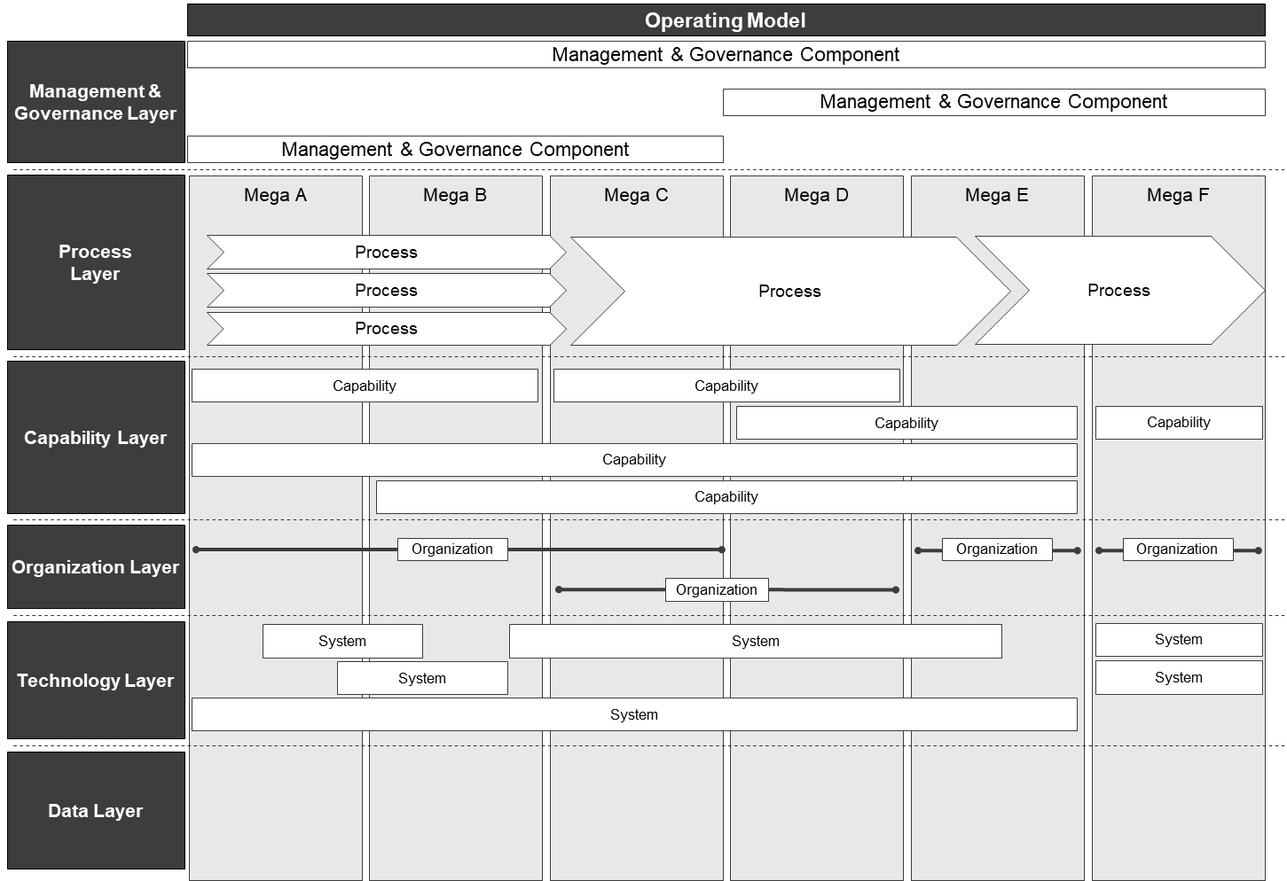
Operating Model Template – Method
How you use it
Step 1. Give the operating model a name, for example “Regional Manufacturing Operating Model”
Step 2. Choose the layers that are most applicable to the scope, context and purpose of the operating model. See below for other layer options. Order the
layers in a logical sequence from “highest” or top level to “lowest”.
Other Layer Options Product Customer Geography
Market Division Region Channel Sector Supplier Knowledge Regulation

Slide 4
Operating Model Template – Method
How you use it
Step 3. Choose a primary
layer to anchor the model.
This layer should be
segmented in relevant
components which will
then be used to inform
how other layers of the
operating model relate to
the primary layer. In this
example model, the
process layer is the
primary – which has been
broken into 6 mega
process steps and process
flows added to these mega
steps. The rest of the
model will align to the
mega process steps and
process flows
Step 4. For each layer, add | When looking at the | Subsequent panels / | In this example, we can see the mega process
the components that make | model from top to | pages should be | steps (value chain) that is being delivered,
up that layer and align | bottom, it should be | utilized where | how management oversees this value chain,
them appropriately with | clear how the | necessary to describe | what capabilities within the business support
the primary layer and | components work | each layer and the | the value chain, what parts of the organization
other related layers. | together as an | components within | are involved and what systems and data
 | integrated whole. | each layer. | elements.

Slide 5
Operating Model Template – Example
 | Service Delivery Operating Model
Management & Governance Layer | Executive Management Committee
 | Service Assurance Leadership Team
 | Sales Operations Leadership Team
Configure
Price
Quote
Order
Operate
Bill
Process Layer
Product A CPQ
Product B CPQ
Fulfilment
Invoicing to Collections
Product C CPQ
Quote & Sales Management
Capability
Capability
Layer
Order Management
Mediation
Customer Management
Rating
Product Management
Organization
Layer
Sales
Operations
Billing Ops
Delivery
System A
System C
System D
Technology Layer
System B
System E
System
Customer Data
Usage Record
Data Layer
Quote Data
Order Record
Billing Record
Service Record

Slide 6
Operating Model Template – Template
<name>
<layer>
<management>
<step>
<step>
<step>
<step>
<step>
<step>
<layer>
<process>
<capability>
<layer>
<layer>
<organization>
<system>
<layer>
<data>
<layer>

