Slide 1

Pain Point Analysis Template
A proven approach for representing, assessing and prioritizing the critical issues impacting a business process

Slide 2



Pain Point Analysis – Overview
What is it
Pain Point Analysis is a method for assessing the issues impacting the performance of a business process by considering the relative weighting of process issues across two dimensions. The analyst can choose the most relevant dimensions, however a typical combination is impact or severity combined with volume or frequency. An alternate to volume / frequency in some situations is detectability.
When to use it
Pain Point Analysis is a useful tool when assessing the current state performance of a business process and seeking to identify areas to focus remediation activity based on the likely return on effort. In other words, where will improvement time and resources reduce the most process pain. Effective use of the method is reliant on having stakeholders with suitable knowledge of process’ current performance as well as the availability of relevant process performance data (e.g. volumes, error rates)
Why use it
Typically, processes will underperform across a range of areas – and a structured method for determining where to prioritize effort is critical to any process improvement exercise. Using Pain Point Analysis, a business analyst can guide an organization to agree on where maximum pain is being experienced and therefore where it is most essential to focus improvement effort and resources. Following Pain Point Analysis, Solution Ideation and Assessment are used to asses effort, feasibility and risk of solutions.

Slide 3

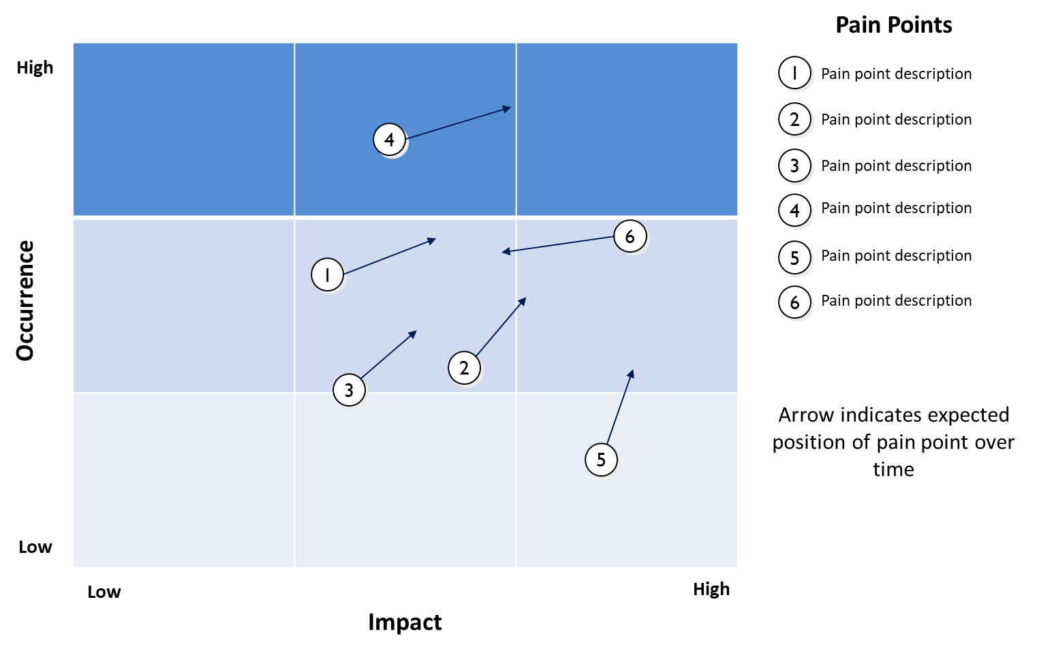
Pain Point Analysis – Method
How you use it
Step 3. Plot the known pain points on the matrix at the corresponding location. Solicit input from subject matter experts, process users and other stakeholders.
Step 4. Indicate with an arrow the expected trend for the pain point if no remediation activity is initiated. No arrow indicates no change expected.
Step 5. Capture the summary details of each of the pain points alongside the grid
Step 2. Use the grid – measured from low to high on each axes to plot each process pain point
Step 1. Decide on the most appropriate axes for the assessment. Here we use Occurrence vs Impact.

Slide 4
Pain Point Analysis – Template
Pain Points
High
1
Pain point description
2 Pain point description
4
3
Pain point description
4
Pain point description
Occurrence
6
5
Pain point description
1
6
Pain point description
2
3
Arrow indicates expected position of pain point over time if no remedial action is taken
5
Low
Low
High
Impact

