Slide 1
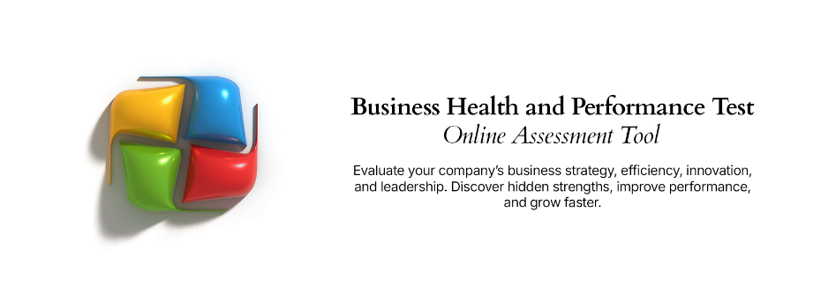
Solution Assessment Method
A proven approach for assessing the value and risk associated with potential business improvement solutions

Slide 2



Solution Assessment – Overview
What is it
The Solution Assessment Method is a proven approach for evaluating potential business improvement solutions and initiatives across a range of essential dimensions. The approach provides an objective lens when reviewing potential solutions that are identified to address business performance issues and their underlying root causes. The method is highly adaptable, easily customized to suit the specific application and accommodate different assessment criteria and weightings.
When to use it
The Solution Assessment Method is best suited once current state analysis has been conducted and a clear, accurate view of business performance issues, pain points are understood and potential solutions have been ideated. With the potential solutions that have been brainstormed or proposed, the Solution Assessment Method can be utilized to evaluate and prioritize the solutions with the aim of selecting the solutions which deliver the greatest business value with the least risk.
Why use it
The Solution Assessment Method is proven, flexible, adaptable and easy to use. It is intuitive for stakeholders involved in the process and for those who get to see and endorse the outcomes. The technique brings the right level of objectivity to what can be a political and subjective exercise, but without bogging down a business improvement program in overly complex and time wasting analysis.

Slide 3

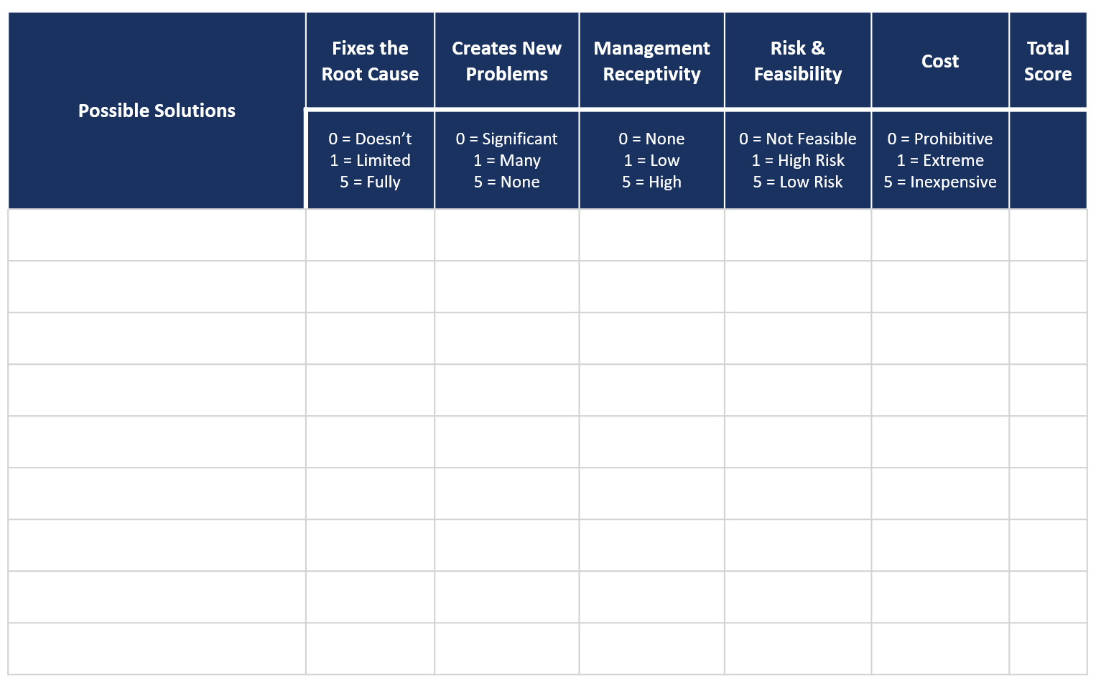
Solution Assessment – Method
How you use it
Step 2. Allocate a score to the solution for its ability to resolve the root cause of the problem.
Step 3. Allocate a score to the solution for its likelihood to create any new problems.
Step 4. Allocate a score to the solution for the likelihood that business management will be receptive to its adoption.
Step 5. Allocate a score to the solution for the relative risk associated with its implementation.
Step 6. Allocate a score to the solution for the relative cost associated with its implementation.
Step 7. Tabulate the scores for each solution by adding the values in columns 2 through
6.
Step 1. List the solutions that have been identified through the solution ideation process.
Step 8. Rank the solutions by total score and select a finite number of the highest ranking solutions to proceed into more detailed evaluation and design.

Slide 4
Solution Assessment – Template
Possible Solutions | Fixes the Root Cause | Creates New Problems | Management Receptivity | Risk & Feasibility | Cost | Total Score
 | 0 = Doesn’t 1 = Limited 5 = Fully | 0 = Significant 1 = Many 5 = None | 0 = None 1 = Low 5 = High | 0 = Not Feasible 1 = High Risk 5 = Low Risk | 0 = Prohibitive 1 = Extreme 5 = Inexpensive

