Slide 1
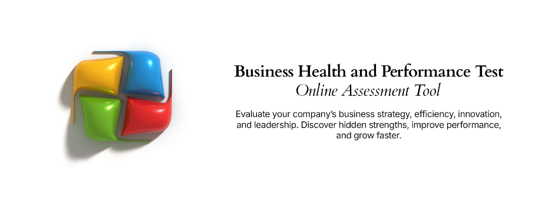
Solution Ideation & Ranking Template
A structured and proven approach for brainstorming and prioritizing business improvement initiatives

Slide 2



Solution Ideation & Ranking – Overview
What is it
Solution Ideation and Ranking is a proven, structured approach for brainstorming and prioritizing potential business improvement initiatives. The method utilizes a scoring system to measure the positive impact of potential business improvement projects against a set of targeted business metrics. The metrics should be chosen based on identified areas within the business where performance improvement is desired and the metrics are confirmed measures of associated performance improvement in the area.
When to use it
This method is useful when exploring potential initiatives to drive business improvement. It is best used after current state analysis has been performed and there is general agreement on what areas within the business are in need of performance improvement. The method is effective in workshop settings and the steps outlined on the following page can be used by a competent facilitator with an audience of stakeholders to arrive at a good outcome – a finite set of prioritized initiatives to assess further.
Why use it
The Solution Ideation and Ranking Method brings a level of structure and objectivity to what can sometimes be a subjective and emotional process – choosing which initiatives to prioritize. Led by a competent business analyst or facilitator, this technique is very useful at taking a long list of possible ideas and paring it down to a much shorter list of initiatives that can evaluated further. The method is also effective at soliciting executive endorsement for prioritization – given the structured process applied.

Slide 3

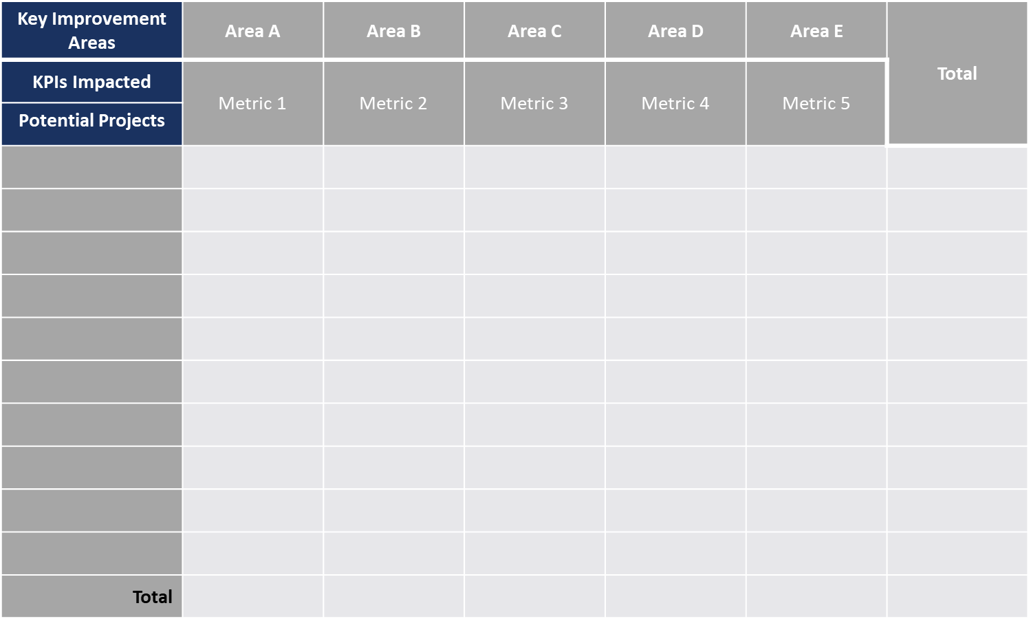
Solution Ideation & Ranking – Method
How you use it
Step 2: For each improvement area, identify and list the metrics that can be used to quantify a tangible improvement in the associated area. More than 1 metric can be listed for each area, list them separately (see example).
Step 5: Tally the scores for each project. Further assessment, scoping, design and implementation effort should then be allocated to the projects with the highest cumulative scores.
Step 1: List the key areas of the business or process area where improvement is needed or being targeted.
Step 3: Brainstorm the potential projects or initiatives that could be implemented in the business to drive improvement. Existing known project ideas can also be included in the assessment.
Step 4: For each project, allocate a score (1-5) representing the degree to which the project will have a positive impact on the KPIs identified. 0 or blank = none, 1
= minimal, 3 = moderate, 5 = significant.
Step 6: Use the bottom tallies to validate appropriate coverage across the different areas needing improvement. Additional projects may need to be identified if certain areas are not being addressed for improvement.

Slide 4
Solution Ideation & Ranking – Template
Key Improvement Areas | Area A | Area B | Area C | Area D | Area E | Total
KPIs Impacted | Metric 1 | Metric 2 | Metric 3 | Metric 4 | Metric 5
Potential Projects
Total

Slide 5
Solution Ideation & Ranking – Example
Key Improvement Areas | Growth | Customer Satisfaction |  | Costs |  | Total
KPIs Impacted | Revenue | NPS | Complaints | Time to Market | Headcount
Potential Projects
Project 1 | 1 | 2 | 2 |  |  | 5
Project 2 |  | 1 | 2 | 4 |  | 7
Project 3 |  | 3 | 1 |  | 3 | 7
Project 4 |  | 3 |  | 2 |  | 5
Project 5 |  |  |  |  | 4 | 4
Project 6 | 2 |  | 4 |  | 5 | 11
Project 7 |  | 1 |  |  | 5 | 6
Project 8 | 2 |  | 3 |  |  | 5
Project 9 |  | 3 | 2 | 4 |  | 9
Project 10 |  | 4 |  | 2 |  | 6
Total | 5 | 17 | 14 | 12 | 17

